Slide 1
Army Institute Of Technology
Department Of Information Technology
BE Project Review -II
Topic:- Fake job prediction using deep learning
Name :- Piyush Raj Mohit Kumar Rohit Yadav
Guide :- Prof. Geeta Patil

Slide 2
PROBLEM STATEMENT
Rising Cybercrime: Online recruitment fraud increased by 300% since COVID-19
Financial Losses: Job seekers lose millions annually to fake job scams
Limited Solutions: Existing systems have poor detection accuracy (50-70% recall)
Class Imbalance: Fraudulent posts are only 2% of total job listings

Slide 3

LITERATURE SURVEY

Slide 4
Sr.No | Paper Name/title | Source of paper/Year | Methodology | Future Scope/shortcomings | Findings
1. | Real or Fake Job Posting Detection Dataset :- Employment Scam Aegean | International Research Journal on Advanced Engineering and Management, 2024 Link | Uses machine learning classifiers (KNN, SVM, Random Forest, Logistic Regression, Naive Bayes, AdaBoost) with NLP preprocessing on Kaggle dataset. Includes EDA, data augmentation, and multi-class classification. | Explore advanced ML models and larger datasets. Address data imbalance, scalability, and maintenance issues. | Random Forest achieved 97.2% accuracy. Effective in classifying real/fake jobs; thorough EDA and preprocessing improved results.
2. | Fraud-BERT: Transformer based context aware online recruitment fraud detection Dataset :- Employment Scam Aegean | Discover Computing, 2025 Link | BERT-based transfer learning fine-tuned on Kaggle imbalanced fake job dataset. Compared with baseline ML (RF, NB, SVM, LR) and DL (Bi-LSTM) models. | High computational overhead and sequence length limits. Explore efficient BERT variants (DistilBERT, XLNET) and address ethical concerns. | Fraud-BERT outperforms baselines with 97% accuracy and 0.93 F1-score. Handles imbalance without resampling; robust for contextual fraud detection.

Slide 5
Sr.No | Paper Name/title | Source of paper/Year | Methodology | Future Scope/shortcomings | Findings
3. | Improving fake job description detection using deep learning-based NLP techniques Dataset :- Employment Scam Aegean | Journal of Information and Telecommunication, 2025 LINK | NLP2FJD framework using Word2Vec embeddings, CNN, BoW, meta-feature extraction. Combined in deep learning model for imbalanced data. | Develop online learning models and multilingual extension. Customize ML models for different languages. | NLP2FJD outperforms baselines with 96% accuracy and 0.93 recall. Advantages in handling imbalanced data via embeddings and meta-features.
4. | Detecting Fake Job Postings Using Bidirectional LSTM Dataset :- Employment Scam Aegean | International Research Journal of Modernization in Engineering Technology and Science, 2023 Link | Bidirectional LSTM deep learning model with text and numeric features. Compared with ensemble models (Random Forest, LightGBM, GBM). | Address class imbalance and improve transfer learning. Enhance explainability and consider ethical concerns. | Bi-LSTM achieved 98.71% accuracy and 0.91 ROC-AUC. Outperforms ensemble models; effective for sequential text patterns.

Slide 6
LITERATURE SURVEY SUMMARY
APPROACH | PROS | CONS | BEST FIT
Traditional ML Classifiers (KNN, SVM, Random Forest, Logistic Regression, Naive Bayes, AdaBoost) | Simple, interpretable, fast training and evaluation; effective on structured data | Limited contextual understanding; manual feature engineering required; sensitive to data imbalance | Baseline models for comparison and rapid prototyping
Transformer-based (Fraud-BERT) | Context-aware representation, high accuracy and F1-score; handles semantic nuances in text | High computational cost, large memory requirements; limited sequence length | Enterprise-scale fraud detection needing contextual understanding
Deep Learning (NLP2FJD: CNN + Word2Vec + Meta-Features) | Automatically learns features, effective for imbalanced data; captures semantic and syntactic patterns | Requires large datasets, slower training; limited explainability | Text-heavy domains requiring automated feature extraction
Bidirectional LSTM (Bi-LSTM) | Captures long-term dependencies in text; high accuracy and ROC-AUC; strong sequence modeling | High training time, complex tuning; less interpretable | Sequential fraud detection tasks and text-based anomaly detection
Ensemble + Hybrid Deep Learning (e.g., CNN-LSTM with EDA & Augmentation) | Combines strengths of multiple models; improves robustness and generalization; mitigates overfitting | Computationally intensive; requires careful balancing and preprocessing | Scenarios demanding high accuracy and reliability across diverse job posting data

Slide 7
Solution Innovation
AI-Powered Detection: Uses BERT (Google's advanced NLP model)
Smart Data Balancing: Implements SMOTE(Synthetic Minority Over-sampling Technique ) variants to handle data imbalance
Real-time Analysis: Provides instant fraud scoring for job postings
Multi-source Data: Collects from LinkedIn APIs + third-party providers

Slide 8
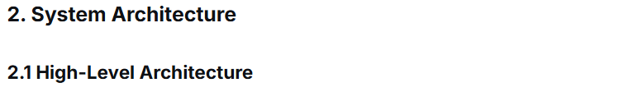
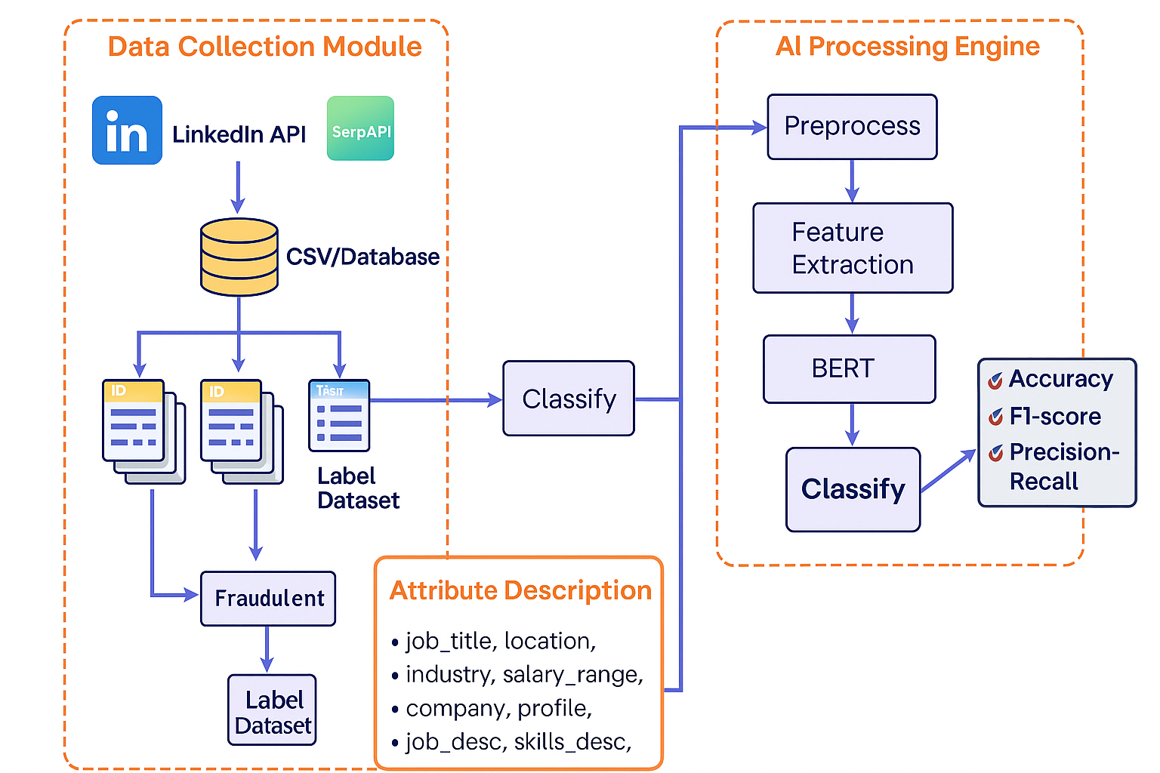

Slide 9
Key Modules of the System
1. Data Collection Module
Goal: Gather and organize real-world job postings for analysis.
Steps:
Fetch Job Listings:
Use LinkedIn API to collect real job postings (title, description, company info, etc.).
Use SerpAPI to gather additional listings from other job platforms.
Store Data:
Save all collected data into a CSV file or database for consistency.
Label Dataset:
Mark each job as “Real (0)” or “Fake (1)” using verified datasets like Fake Job Posting Dataset (Kaggle) or known ground truth.
Attributes Captured:
job_title, location, industry, salary_range, company_profile,
job_desc, skills_desc, employment_type, fraudulent, and combined text.

Slide 10
2. AI Processing Engine
Goal: Analyze text and detect fake job postings using NLP and ML.
Steps:
Preprocessing:
Clean text (remove HTML tags, stop words, special characters).
Standardize formats and combine text fields.
Feature Extraction:
Extract important text features from job descriptions and company profiles.
Use text column as the main input for NLP models.
Handle Class Imbalance:
Apply SMOTE and its 10 variants to balance real vs fake job counts (since real jobs > fake jobs).
Train AI Model:
Use BERT (Bidirectional Encoder Representations from Transformers) to learn deep contextual meaning of job posts.
Classification:
The trained BERT model predicts each posting as Fake (1) or Real (0).
Evaluation:
Assess model using Accuracy, F1-score, and Precision–Recall metrics.

Slide 11
3. Output & Storage​
Store predictions and performance metrics.​
The final labeled and processed data can be used for future retraining or dashboard visualization.​
​
​

Slide 12
Dataset SURVEY

Slide 13
Dataset Compare
Aspect | Fake job posting detection | ⚪ ESA dataset | ⚪ LinkedIn Job Postings
Dataset Size & Coverage | Massive — over 50,000 entries, covering multiple industries and job types, giving broader learning scope. | Limited (~17,800 entries) — narrow domain and outdated samples. | Large (~124,000 entries) but no fraud labels, making it unsuitable for supervised detection.
Label Availability | Fully labeled with “fake” vs “real” — ready for direct supervised training and evaluation. | Labeled but highly imbalanced, requiring heavy preprocessing. | Unlabeled — needs manual or heuristic labeling.
Data Quality & Completeness | High-quality data with well-structured text fields and fewer missing values — ideal for NLP and deep models like BERT. | Medium — older, incomplete, and noisier; many missing fields. | High for structure, but lacks target variable for fake detection.
Diversity & Realism | Highly diverse — includes various industries, locations, and job types; closer to real-world posting distribution. | Narrow focus — limited diversity and outdated terminology. | Extremely diverse and modern, but only represents genuine jobs.
Recency & Relevance | Recent and more representative of current online job markets — useful for modern fake-job trends. | Outdated (2012–2014) — patterns may no longer reflect current scams. | Recent (2023–2024), but not fraud-related.
Machine Learning Utility | Best suited for end-to-end fake-job detection pipelines — supports deep learning, feature extraction, and evaluation. | Good for benchmarking classic ML models but too small for deep learning. | Useful for pretraining embeddings or unsupervised anomaly detection only.
Generalization Potential | High — large, balanced, and varied dataset reduces overfitting and improves real-world model accuracy. | Low — smaller, biased, and domain-specific; poor generalization. | Medium — can help with representation learning but not fraud prediction.

Slide 14
Dataset : Fake-Job-Posting-Detection
It contains a mix of real and fake job listings from all over the world.
These job posts are clearly marked as real (0) or fake (1), which is great for training supervised machine learning models.
54.4k rows and 10 attributes.
Link: kaggle
32.6K real and 13.5k fake job postings

Slide 15
Attribute Description
• job_title: The title of the job posting (e.g. “Data Analyst”). It tells you what position the job is for. • location: Where the job is based — can be a city, country, or sometimes even “Remote”. • industry: The industry or sector the job belongs to (like IT, Finance, Healthcare, etc.). • salary_range: The salary offered for the job, usually written as a range (e.g. "$50,000 - $70,000"). If it's missing or seems off, it might be a red flag. • company_profile: A short description about the company — who they are, what they do, and sometimes their goals. Scam posts often skip this or copy it from somewhere else. • job_desc: The full job description — includes duties, responsibilities, and other job-related details. • skills_desc: A list or paragraph of required skills for the job (like Python, Communication skills, etc.). • employment_type: The type of job it is — like Full-time, Part-time, Internship, Contract, etc. • fraudulent: The label we're trying to predict — 0 means a real job, and 1 means a fake one. • text: A combined version of all the main text fields — used for feeding into models like BERT.

Slide 16
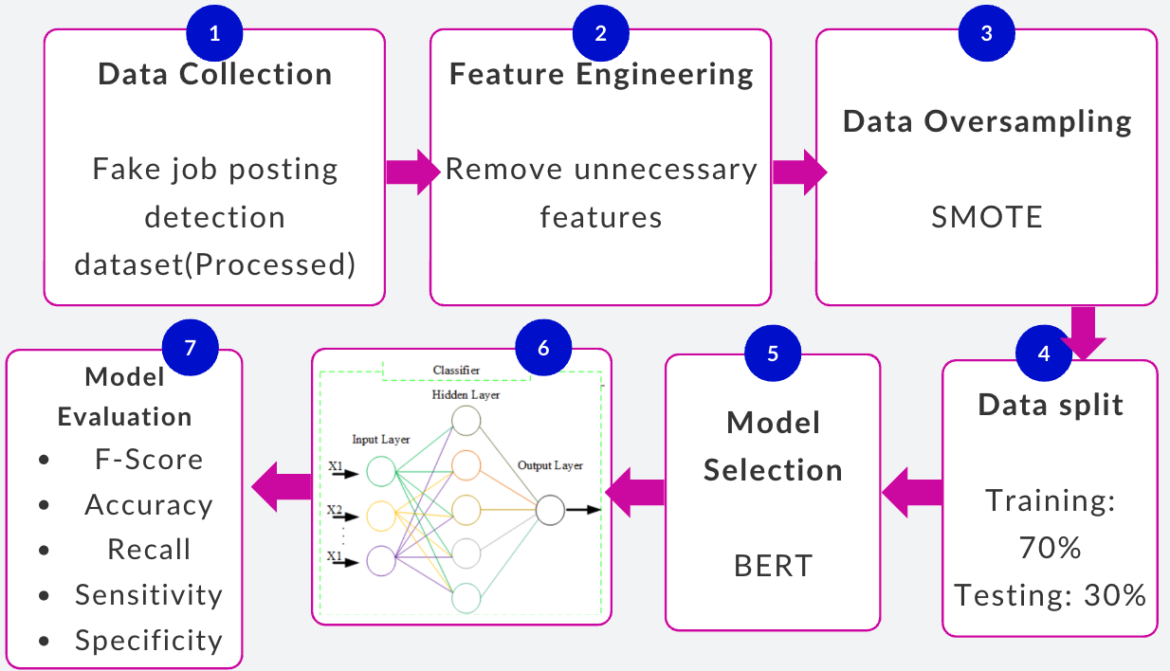
Methodology

Slide 17
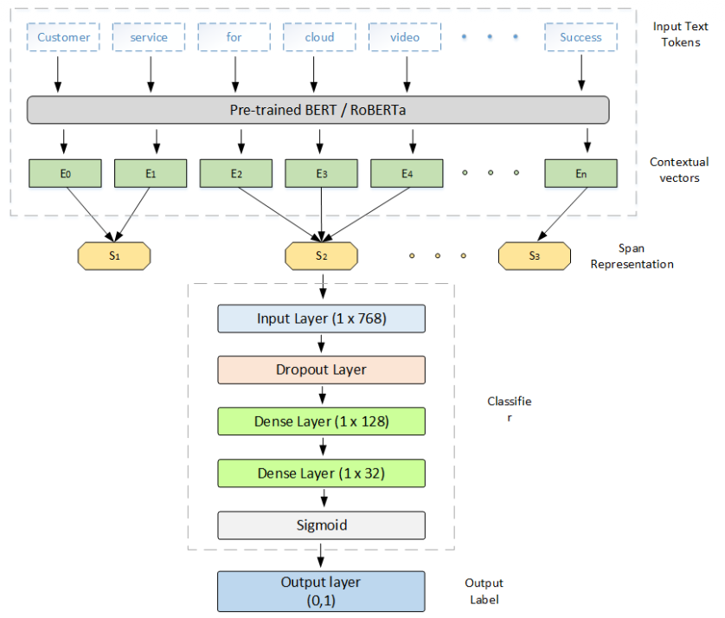
Model Architecture

Slide 18
Pretrain Model :- AventIQ-AI/BERT-Spam-Job-Posting-Detection-Model (1 year Older)
A BERT-based binary classifier fine-tuned to detect whether a job posting is fake or real.
Built on top of bert-base-uncased as the backbone model.
Lightweight and usable on both CPU and GPU for inference
Accuracy: 0.97 on the held-out test set
Precision: ≈ 0.81
Dataset :- Combination Of Multiple custom Dataset
Epochs :- 3
Batch size:- 16
Maximum token length :-128 tokens (longer inputs truncated)

Slide 19
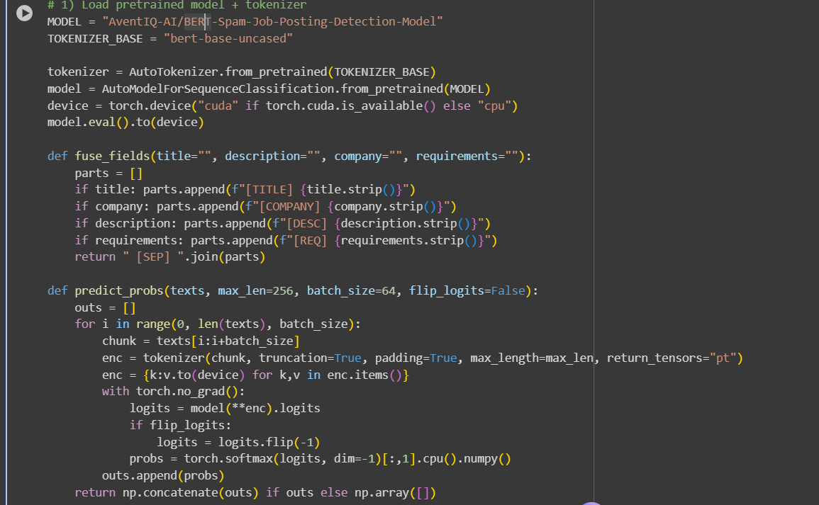
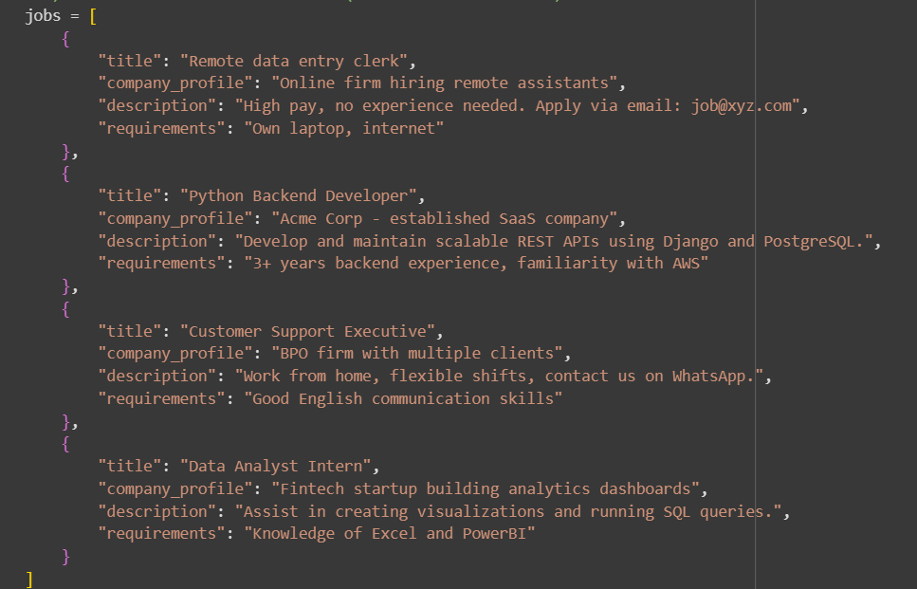
Code For using the Pretrained Model :-

Slide 20
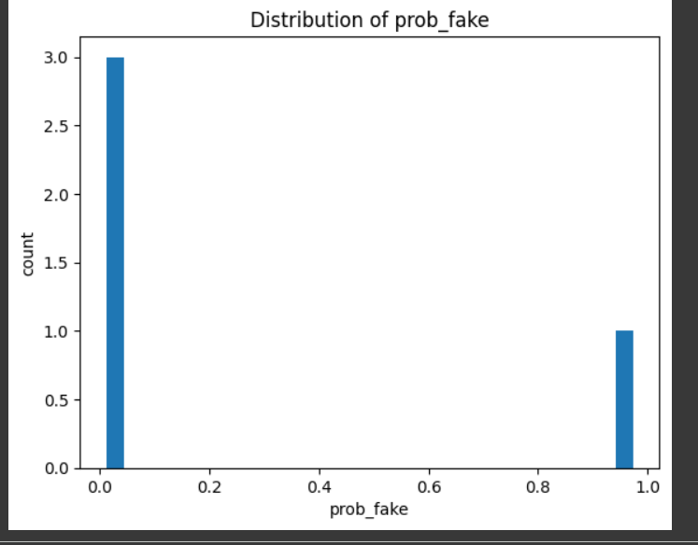
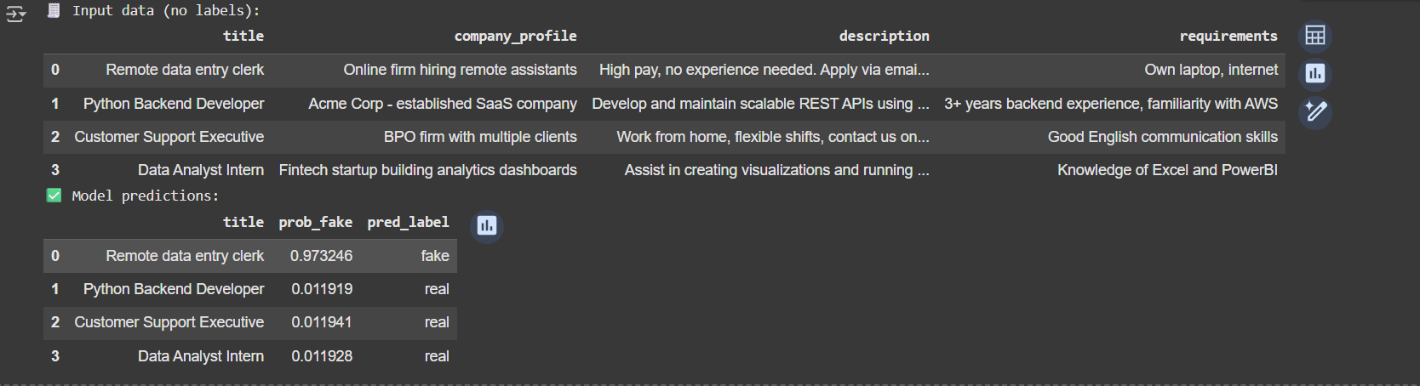
Output Generated :-

Slide 21
Scapper File
→ The scraper is the data collection backbone of the entire fraud-detection system.
The BERT model can’t detect fake postings without real job data to analyze — the scraper automatically gathers those postings from multiple websites in a structured, machine-readable format (CSV/JSONL).
Automated & Scalable Data Extraction
→ Instead of manually copying job details, the scraper automatically extracts thousands of job listings with fields like title, company, location, description, salary, etc.
This ensures large-scale, continuous data flow for both training and real-time prediction.
Smart Crawling with Safety Rules
As new job postings come in, the scraper keeps updating the dataset — enabling continuous retraining and adaptation to new fraud patterns.
End-to-End Integration with Detection Pipeline
→ Once jobs are scraped, their descriptions are automatically passed to the fraud detection model, which predicts the probability of being fake..

Slide 22
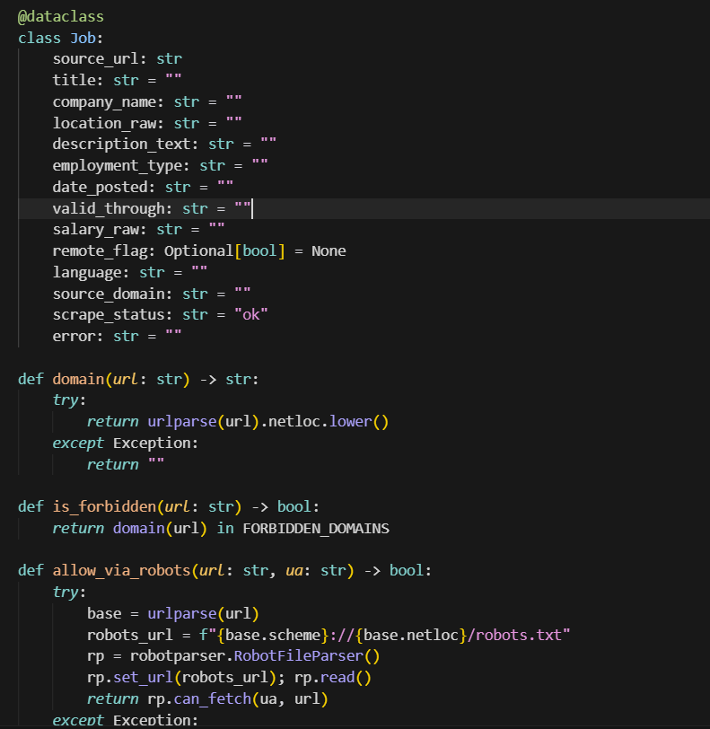
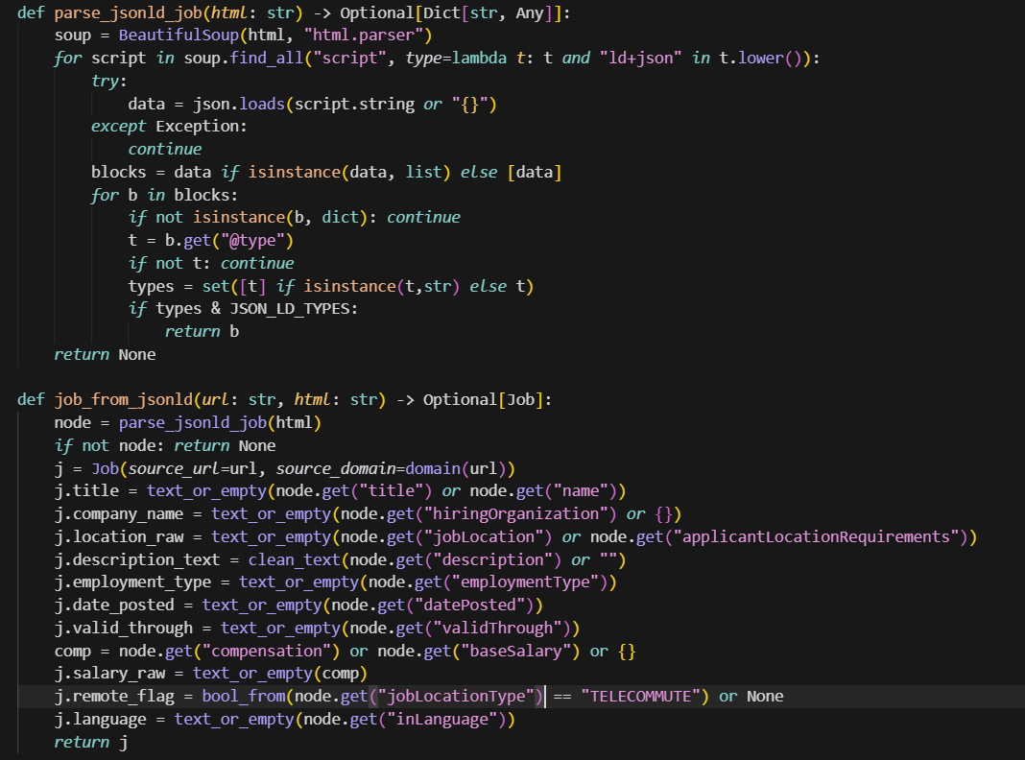
Scrapper File

Slide 23
Plan 2.0
Transfer Learning Implementation We will fine-tune the existing AventIQ-AI/BERT-Spam-Job-Posting-Detection model using our own scraped dataset. This will help the model learn local fraud patterns, regional vocabulary, and current scam trends that were not in the original data.
Continuous Retraining Pipeline Our web scraper will keep collecting new postings every week. These will be reviewed and used for incremental retraining, allowing the model to adapt as new fraud techniques appear.
Domain-Specific Adaptation Focus on Indian and regional job markets—handling terms like “LPA,” “Walk-in,” or “Telegram HR.” This increases accuracy for real-world, localized job postings.
Optimization and Evaluation We’ll test improvements like layer freezing, class-imbalance handling, and threshold tuning to boost precision and reduce false positives.
Scraper → Preprocessing → BERT Model → Fraud Prediction → Dashboard/Alert
⃣ Real-Time Integration Integrate the upgraded model into a live fraud-detection pipeline:

